Slide 1


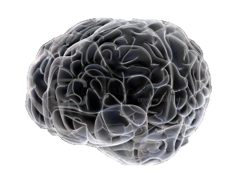
Active Sleep control by Magnetic Stimulation
Global Ph.D Fellowship
2015. 06. 26.
Notes:
Good after noon everyone. It is a great honor to be here, for presenting my research to you.
Today, I would like to propose sleep could be controlled by magnetic stimulation.

Slide 2

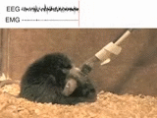
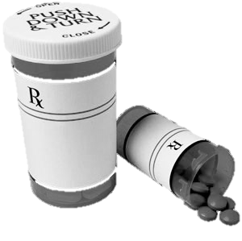



1. Background
Insufficient Sleep
Sleep Regulation with Light
Optogenetics
► Pharmacology
► Limitation
Side effects
Tolerance
Addiction
Drowsiness
Remote
Regulation
Therapeutic
Application
Invasive
Notes:
According to the CDC report, one fourth of adults have a lack of sleep, and it has become a society-wide problem.
This insufficient sleep has been linked to individual health such as cognitive deficits, diabetes, cardiovascular disease, and so on. Therefore, sleep management seems to be important.
In medical field, current approach to manage sleep is limited to pharmacology. However, this approach has various side effects, such as drug tolerance, addiction and drowsiness.
In animal model, it has been proven that light can control sleep behavior.
However, It is very hard to apply to human because it is invasive and has a limitation of remote regulation.
As a result, this technique could not be applied to practical therapy in human.
Therefore, a novel technique which could overcome limitation is required.
--------
To overcome this problem, scientists have suggested another way of sleep regulation using light stimulation.
This is called optogenetics, and as you can see here, it is possible to modulate the sleeping behavior in mice.
Since light cannot penetrate tissues, it requires light delivery inside the brain by mounting optic fiber.
For this reason, it is invasive and has a limitation of remote regulation and therapeutic application.

Slide 3
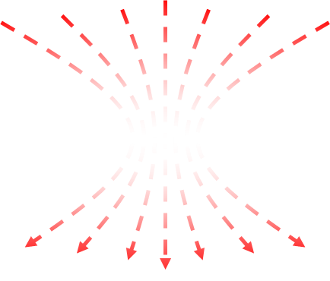
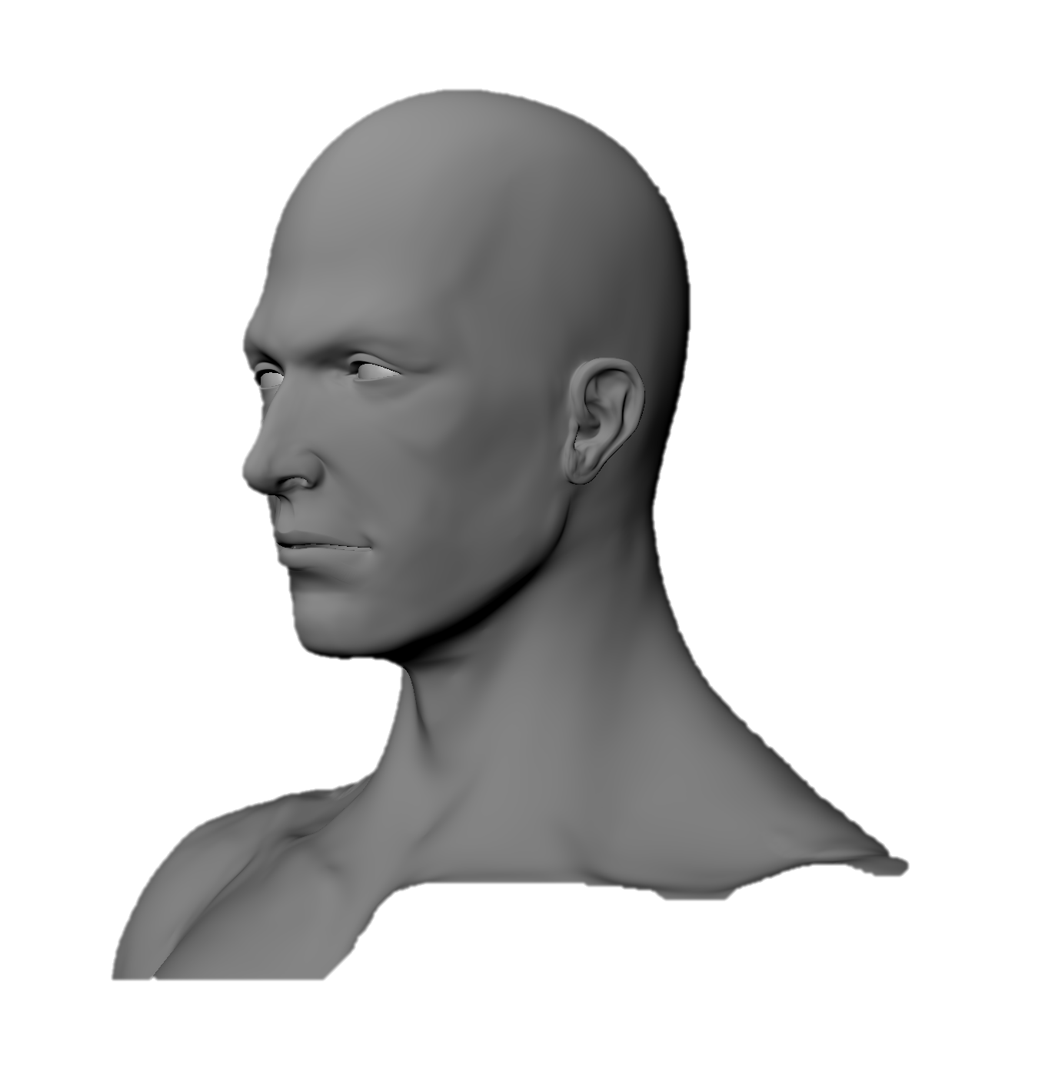
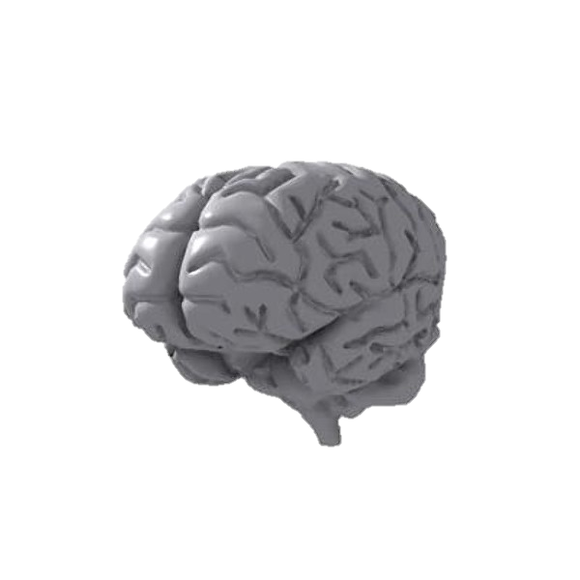
2. Concept : Magnetic Stimulation
Magnetic Field
Non-invasive
Remote Stimulation
Human Application
Brain
Modulation
Sleep
Induction
Notes:
To induce sleep, here I propose magnetic stimulation as a novel technique
The advantages of using magnetic stimulation is that magnetic field can easily penetrate tissues.
Therefore, it is non-invasive, enables remote stimulation, it is suitable for human application
Imagine that simply turning on the magnetic field can solve this sleep problem like this.
This is the ultimate goal of my project.

Slide 4
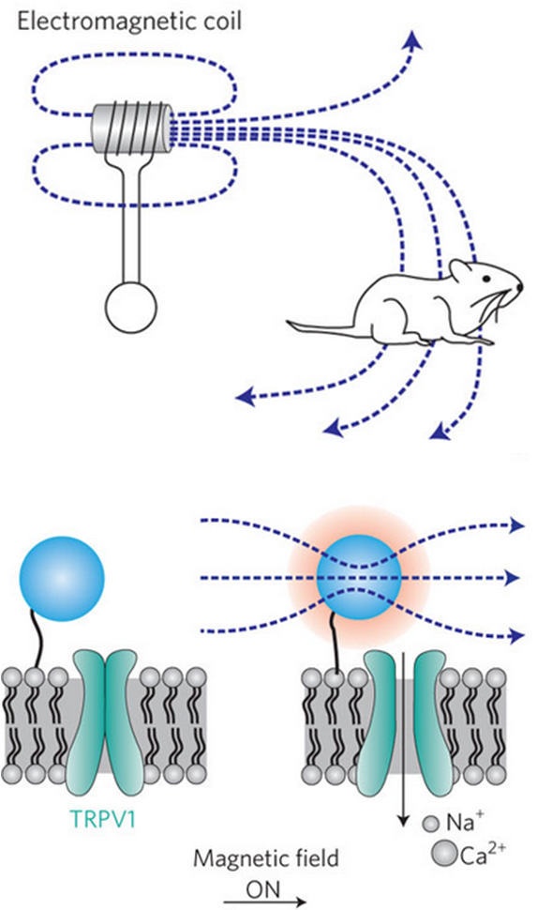
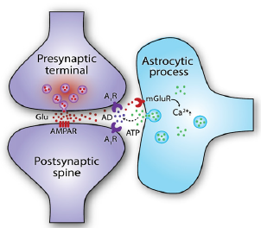
3. Previous Study
Magnetogenetics
Modulates biological system with magnetic field
Astrocyte
Sleep modulators in the brain through ATP release
Pascual et al. Science (2005)
Astrocyte
ATP
Sleep
Knopfel et al. Nat. Nanotech. (2010)
Halassa et al. Neuron (2008)
Notes:
According to the previous study, it is possible to modulate biological system with magnetic field by cutting edge technology called magnetogenetics. This technology convert magnetic stimulation into heat energy, and makes ionic channels to be opened, makes target specific cellular activation through calcium increase.
And also, it has been known that astrocytes can control the sleep behavior through calcium dependent ATP release.
------
Taking advantage of this technology, it might be possible to modulate sleep behavior by targeting the astrocytes which is most abundant cells in the brain. These astrocytes are known to modulate sleep homeostasis by ATP releasing.

Slide 5
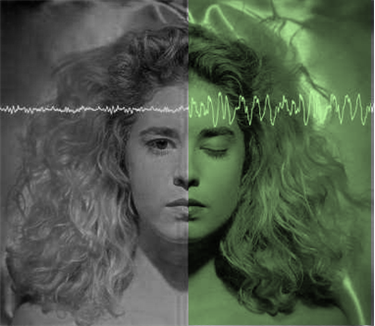
4. Hypothesis
Magnetogenetics
Off
On
+
Astrocytes
Awake
Sleep
Control Sleep
Magnetogenetic Modulation of Astrocytes Controls Sleep
Notes:
Combining these ideas, magnetogenetics and astrocytic function, might be possible to control the sleep behavior,
It it comes true, simply turning on the magnetic field makes sleep.
Therefore, I want to propose my hypothesis that magnetogenetic modulation of astrocytes controls sleep.

Slide 6
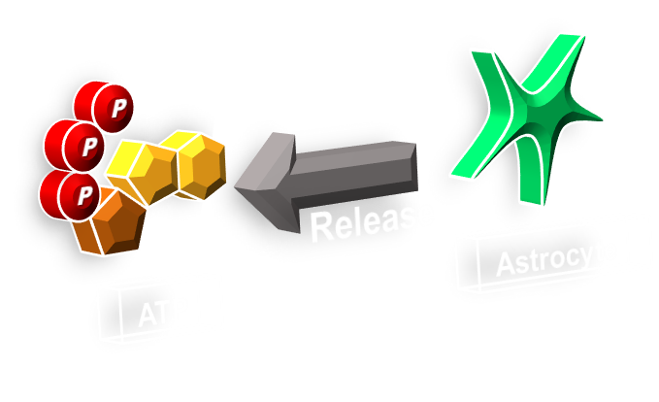
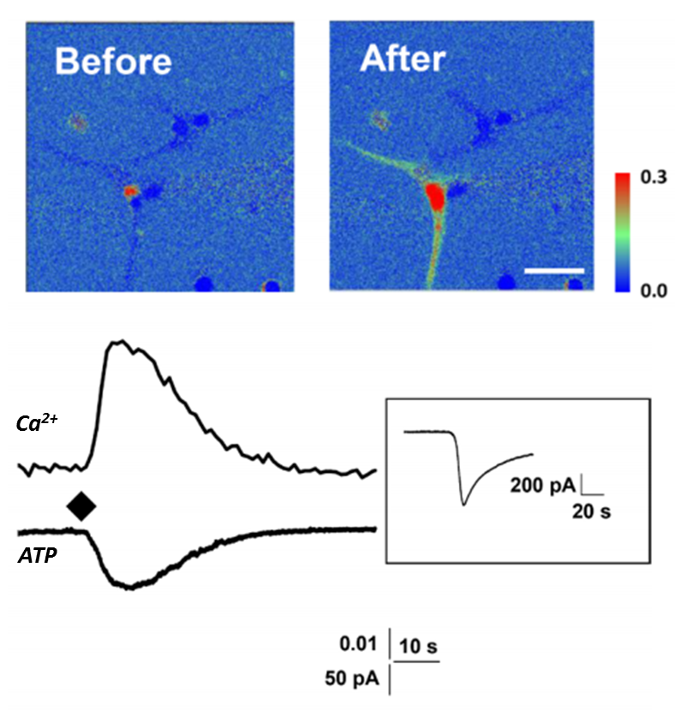
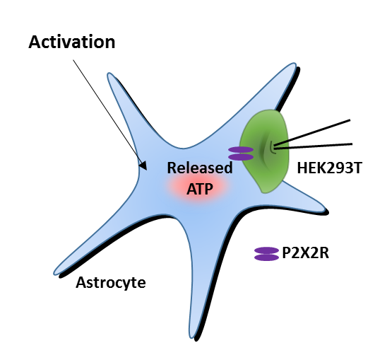
5. Preliminary result
Sniffer Patch Technique
Notes:
At the first step, Taking advantage of sniffer patch technique in our lab, we have confirmed that activation of astrocyte really increases intracellular Ca2+ level and release ATP.
To test my idea, first we have tested that activation of astrocyte really increases intracellular Ca2+ level and release ATP.

Slide 7
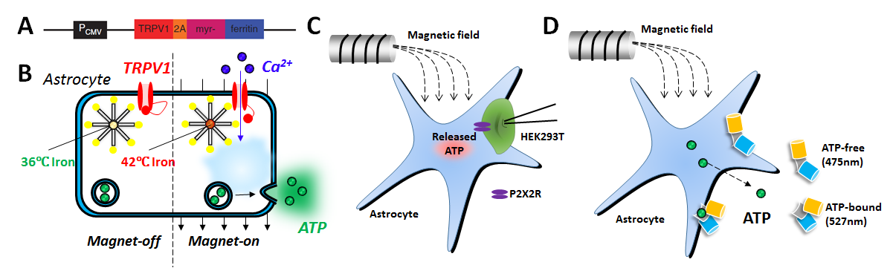
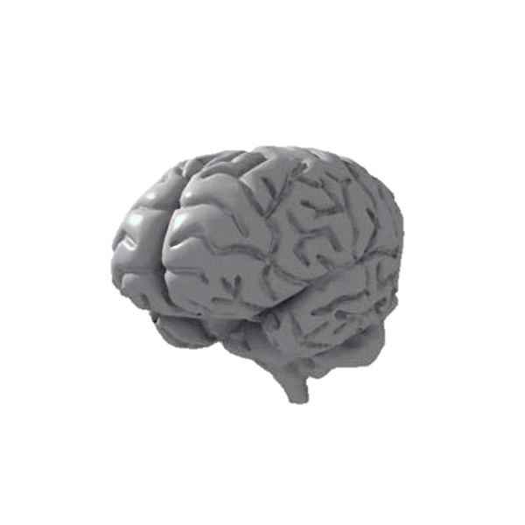
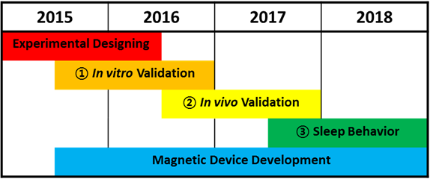
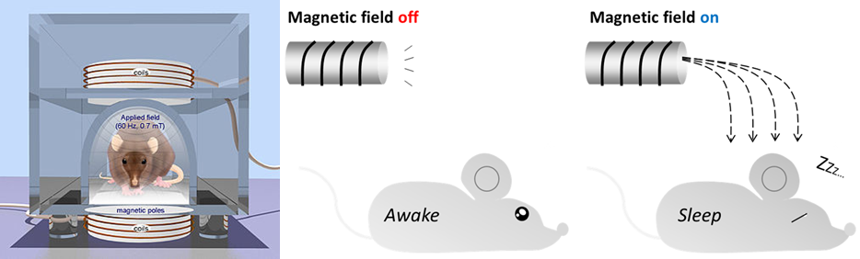
6. Experimental Plan
Magnetic Field
Generator
Viral Vector development
In vitro
Sniffer patch
Activation
In vivo
Microdialysis & HPLC
P
P
P
Release
Astrocyte
Degradation
ATP
In vivo
Ca²⁺ Imaging
Adenosine
Accumulation
In vivo
EEG/EMG recording
Sleep Induction
Notes:
Based on the preliminary result, I have designed further experiments.
This is the exact sleep induction mechanism I am expecting.
Target specific activation of astrocyte with magnetic stimulation will increase intracellular calcium increase and consequently release ATP. This released ATP will be degraded into adenosine and accumulated in the brain. Adenosine is well known neuromodulator that induces sleep pressure.
Every described steps will be tested with various experiments.
Currently, I am developing the magnetic field generator with BioMEMS laboratory and cloning the vectors for specific cell targeting.
From 2015 to 2016, I will do in vitro validation of magnetogenetic modulation of astrocytes with In vitro sniffer patch technique and FRET imaging.
Next from 2016 to 2017, I will perform in vivo experiments such as Microdialysis and HPLC to check in vivo adenosine level and In vivo calcium imaging to see astrocytic activation.
Lastly 2017 to 2018, I will test the sleep change with EEG and EMG recording. One of the expert in sleep research is involved in my project for successful experiment.

Slide 8


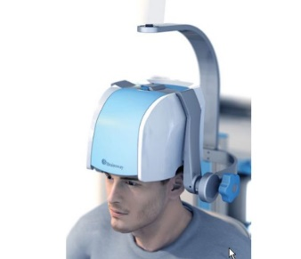
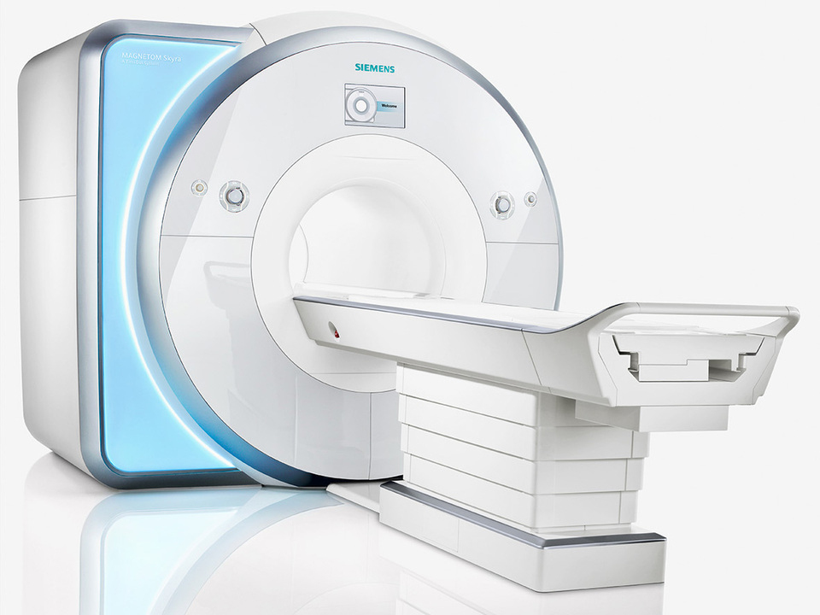
7. Expected impact
The first remote regulation of brain activity with magnetogenetics.
Provide another way of sleep regulation for therapeutic purpose.
8. Application
Magnetogenetics
Gene Therapy
TMS
MRI
Notes:
There will be two expected impacts by achieving this goal
It would be the first remote modulation of brain activity with magnetogenetics
Moreover, this project provides another way of sleep regulation for therapeutic purpose
For my succe, I am the one who know more about magnetic field due to having bachelors degree from one of the best school in Japan. And I am also the one who is studying and researching brain. Therefore, I believe that my degree of electrical engineering in japan and current studying of neuroscience field will lead to success of this multidisciplinary research

Slide 9



9. Eligibility
Bachelor’s Degree in
Electrical & Electronic Engineering
Ph.D course in
Neuroscience
Global Leader

Slide 10

THANK YOU

Slide 11

Supplementary Information

Slide 12
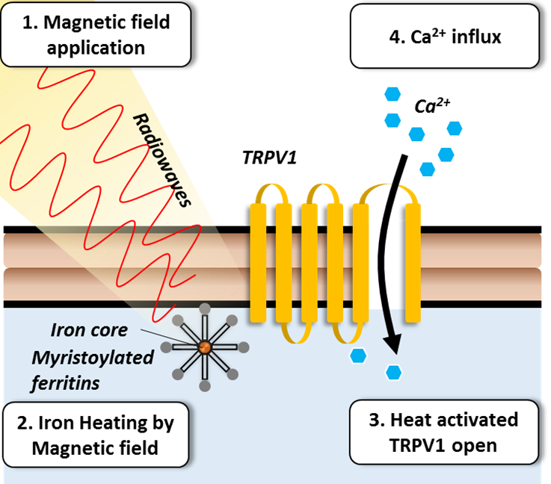
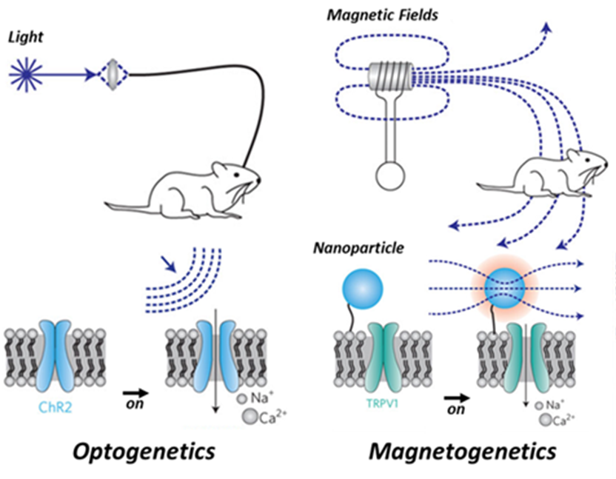



Magnetogenetics (opto vs magneto)
Remote Control of Ion Channels and Neurons
through Magnetic-Field Heating of Nanoparticles (2010)
Radio-Wave Heating of Iron Oxide Nanoparticles Can Regulate Plasma Glucose in Mice(2012)
Remote regulation of glucose homeostasis in mice using genetically encoded nanoparticles (2015)

Slide 13
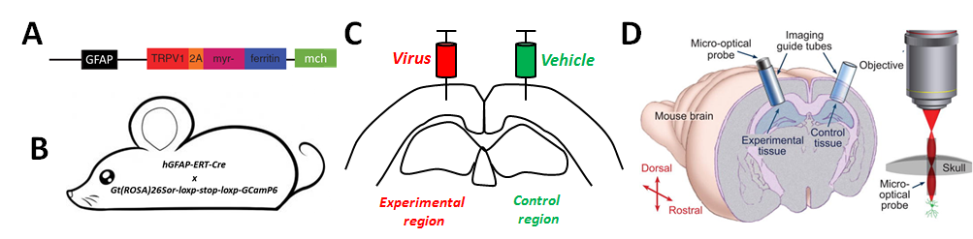
Virus for in vivo experiment

Slide 14
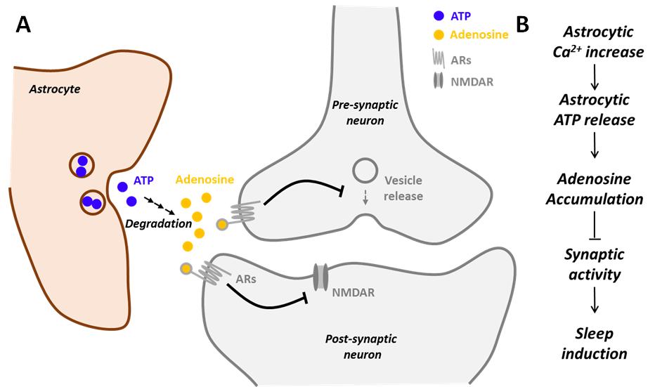
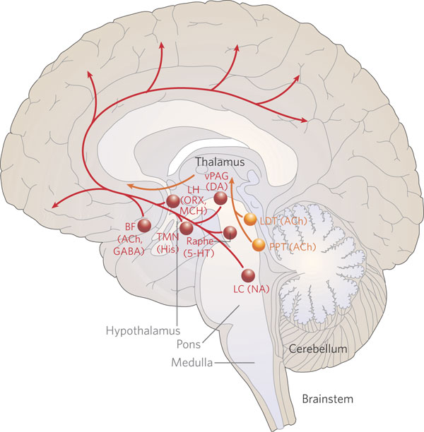

Sleep mechanism and related region
Adenosine: A Mediator of the Sleep-Inducing Effects of Prolonged Wakefulness (1998)
Astrocytic Purinergic Signaling Coordinates Synaptic Networks (2005)
Astrocytic Modulation of Sleep Homeostasis and Cognitive Consequences of Sleep Loss (2008)

Slide 15
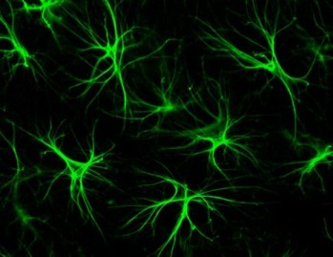
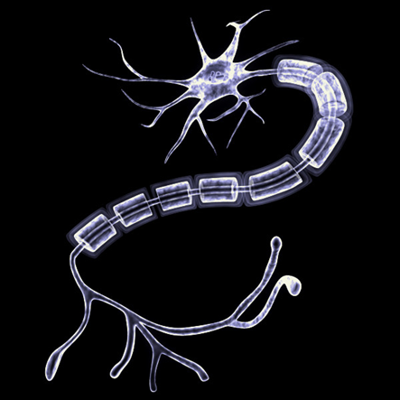
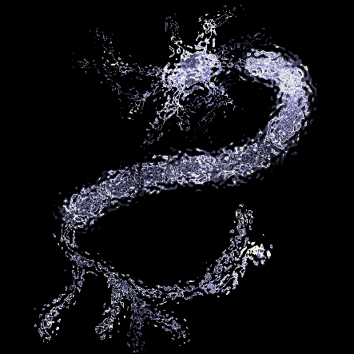
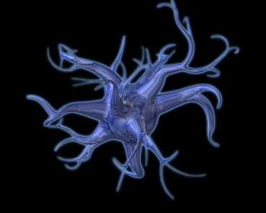
Why astrocyte, Not neuron?
Astrocytes are the most abundant cell in the brain
Other Glia
Astrocyte
Neuron
Astrocytes can proliferate
Neuronal death : No proliferation
Astrocytic death : Proliferation

